Slide 1
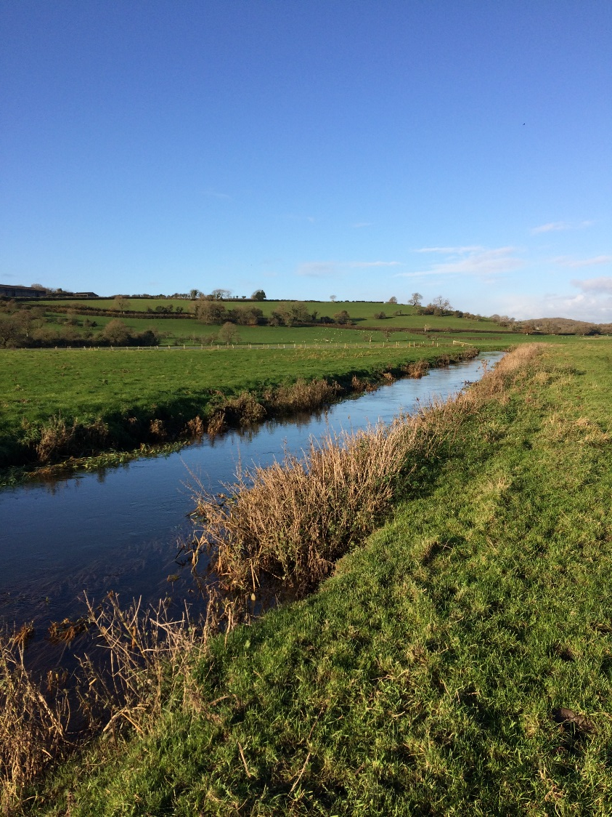
The River Thaw Habitat Enhancement Project

Slide 2
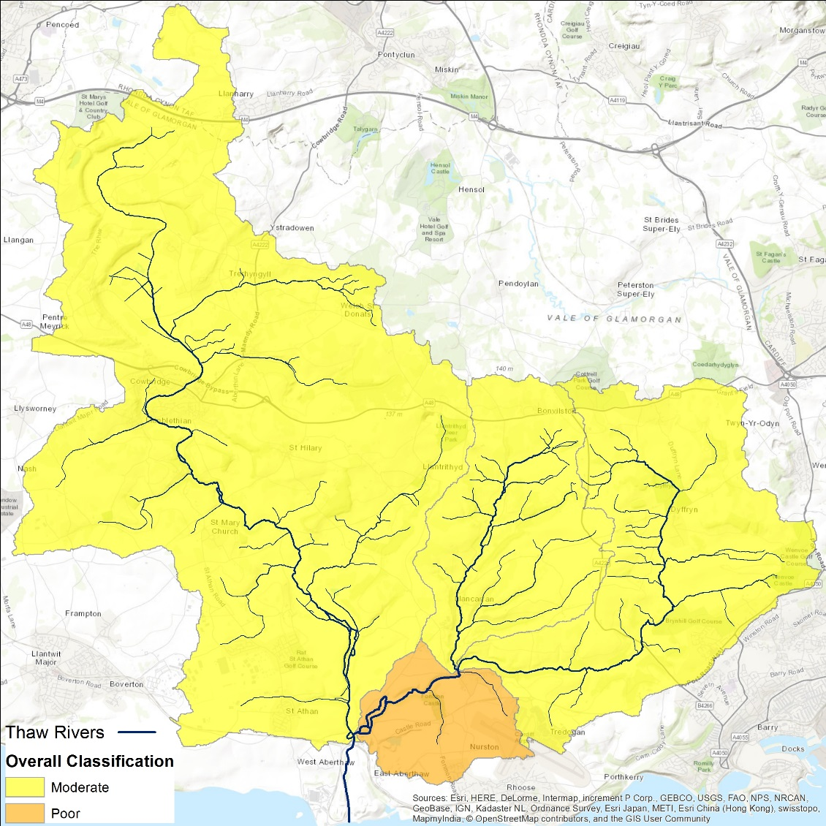
Why?
Previously failing WFD status for fish- Trout
Current WFD status is “GOOD” (borderline)
Too much phosphate
Too much sediment
=Degraded habitat and water quality

Slide 3
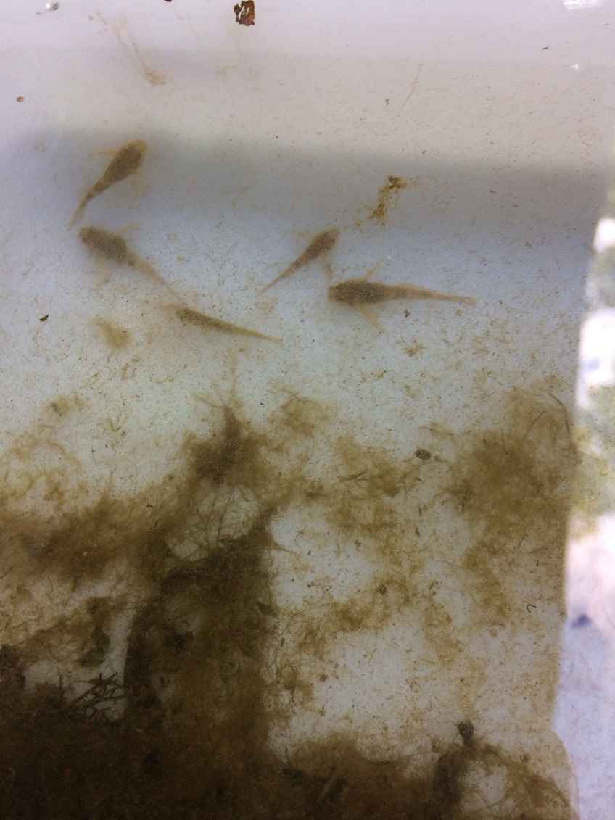
Aims and objectives
To improve the habitat for eels and other migratory fish and trout in the Thaw catchment.
15 farm visits
Riparian fencing to exclude stock with alternative water provided
Instream structure and bankside revetment work
Improve fish access

Slide 4
Implications of phosphate
Excessive nutrient build up in a watercourse
Algal blooms
Eutrophication
Depletes oxygen levels

Slide 5
Implications of SEDIMENT
Poor vegetated and degraded riverbanks
Smother gravel habitat
Deplete oxygen levels
Poor environment for invertebrates and spawning fish

Slide 6
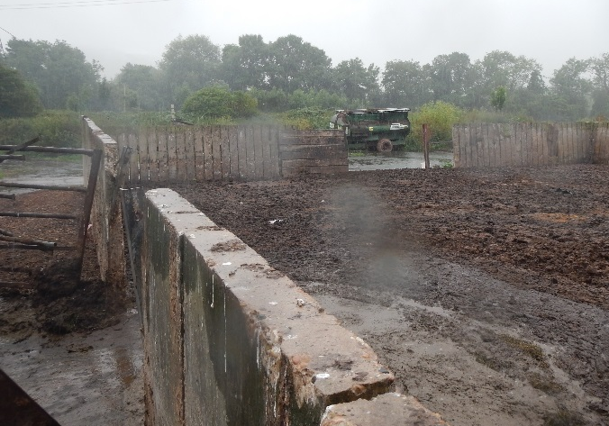
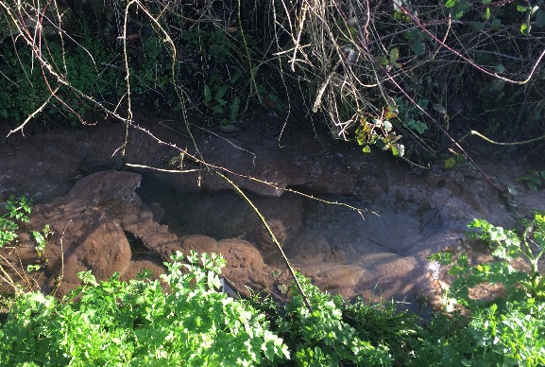
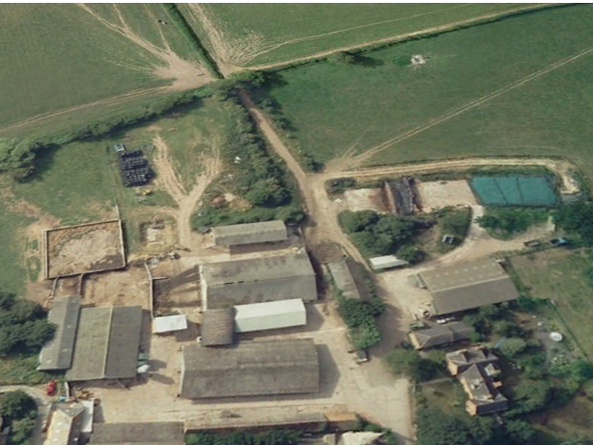
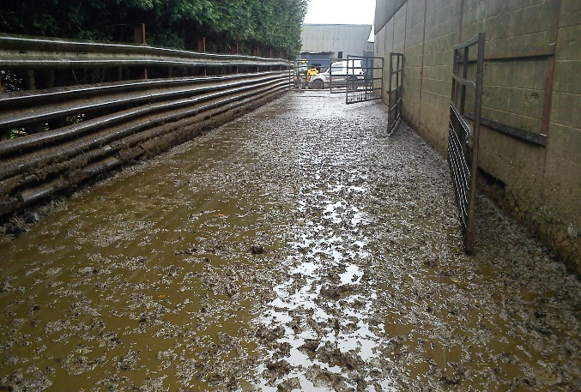
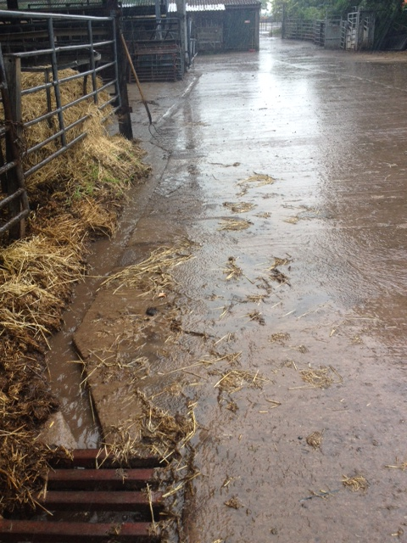
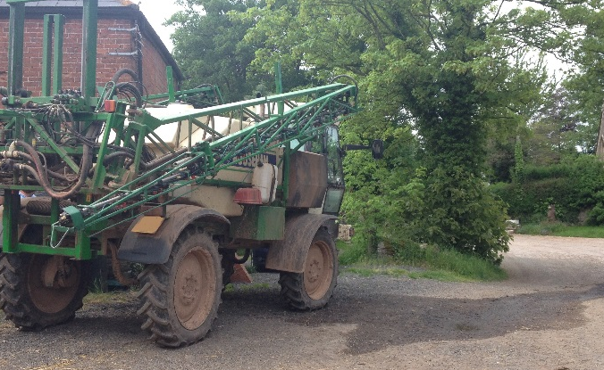
Manure Storage
Farm Visits - Yard Infrastructure:
Condition & Connectivity
Watercourses
Stock Handling Areas
Silage Storage
Clean/Dirty Water Separation
Pesticide Handling
Notes:
LP

Slide 7
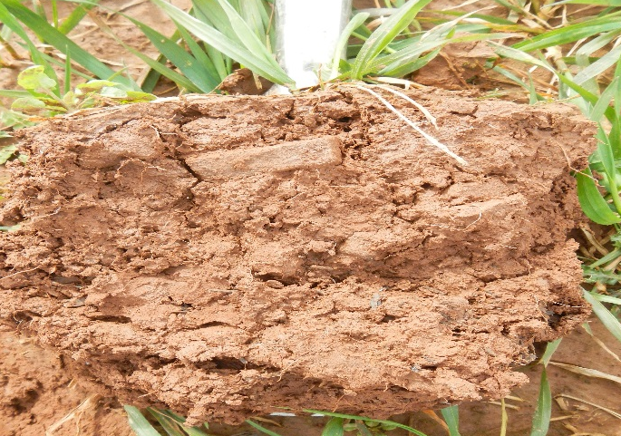
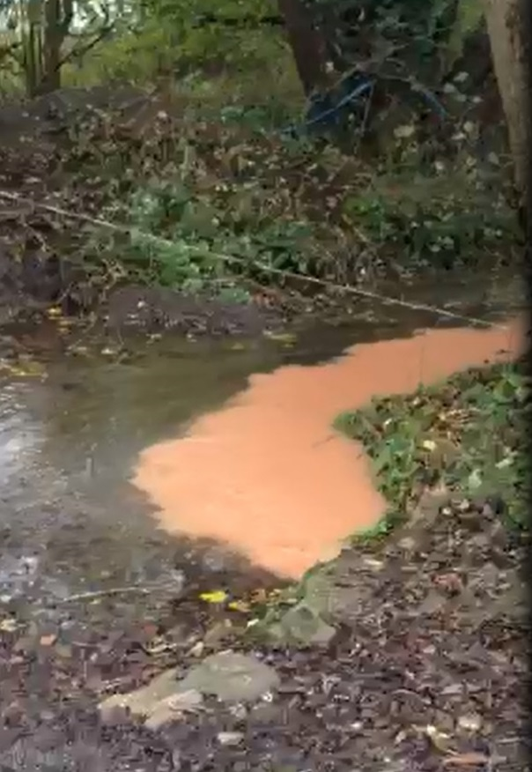
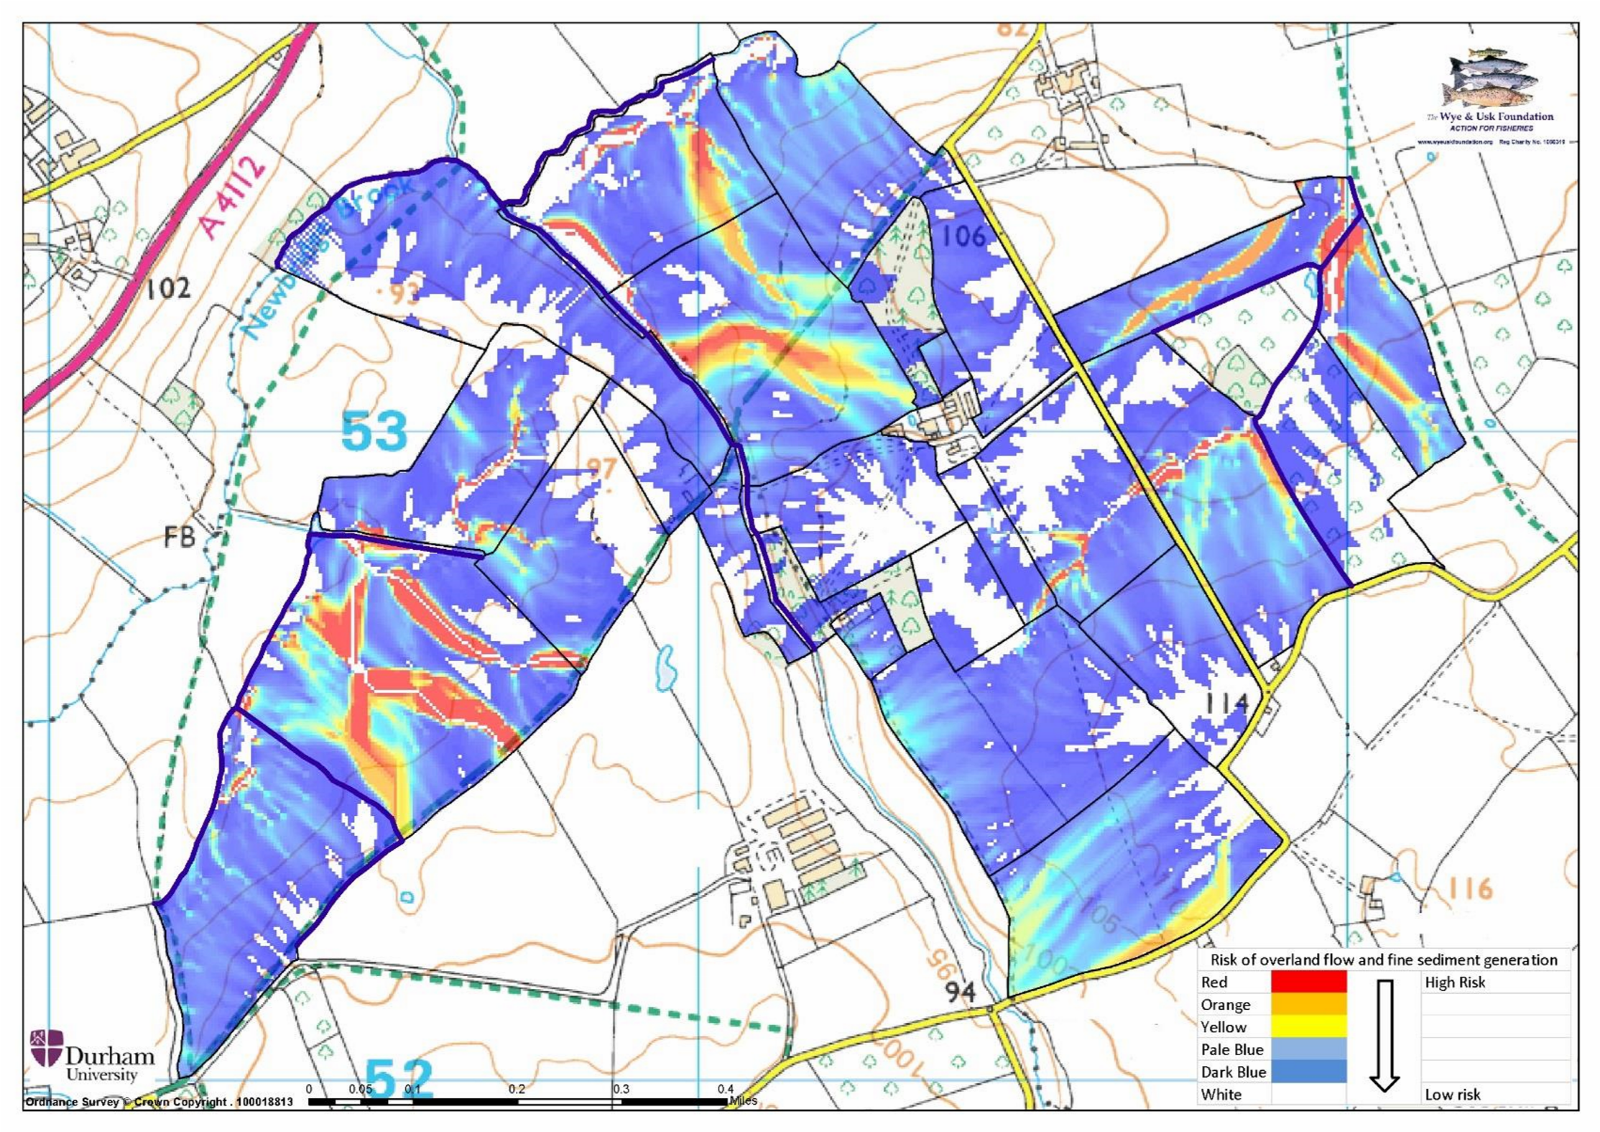
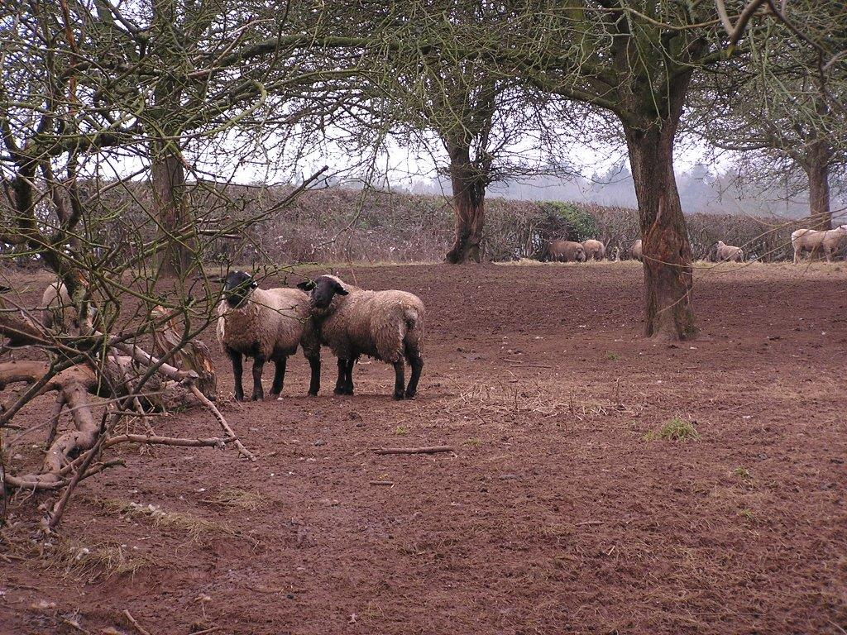
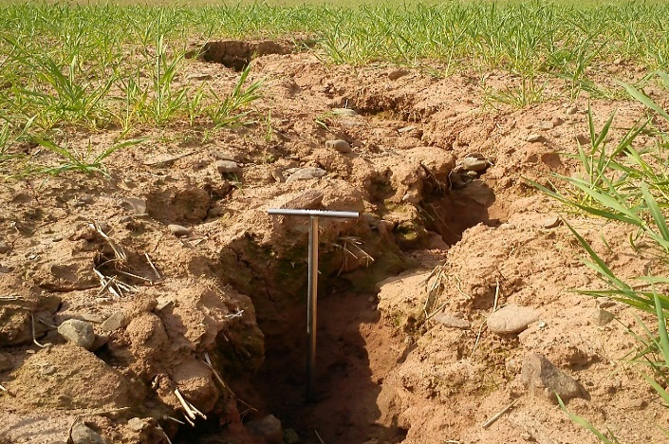
Structure
Farm Visits - Soil Management:
Condition & Connectivity
Watercourses
Grazing Technique
Erosion Gullies
Organic Matter Levels
Soil Biology
Notes:
LP

Slide 8
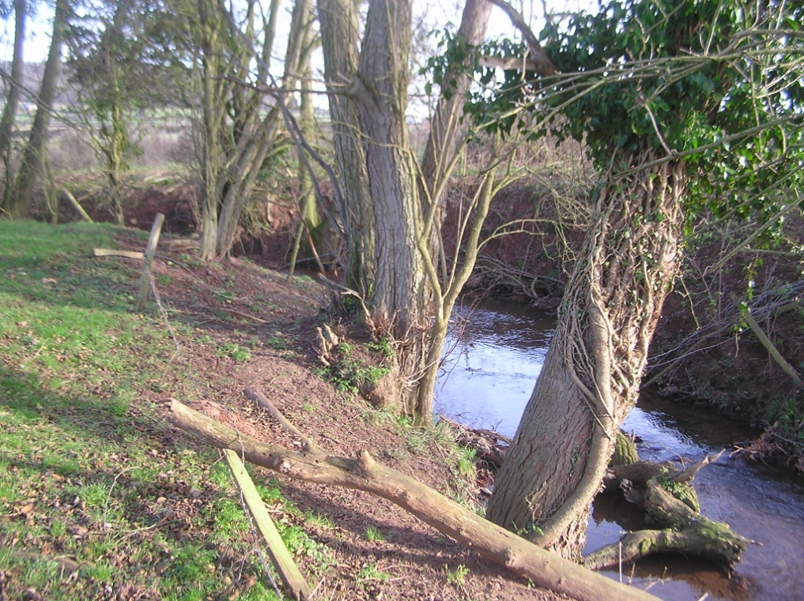
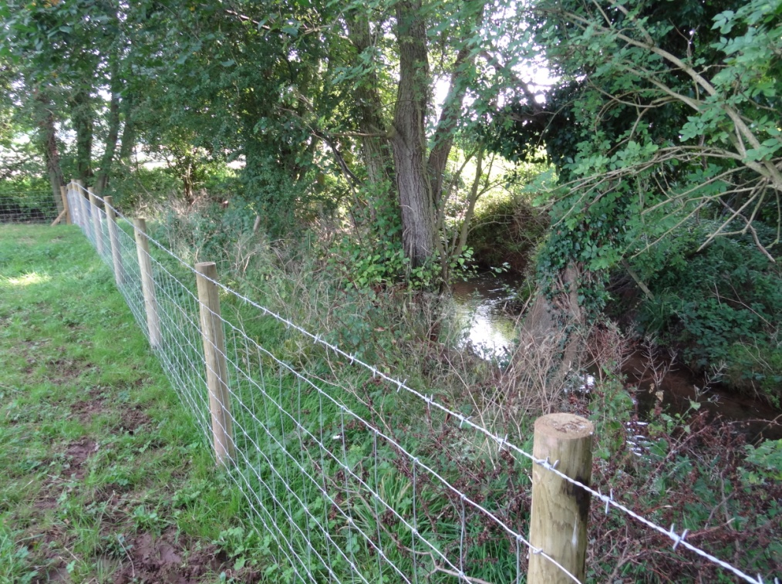
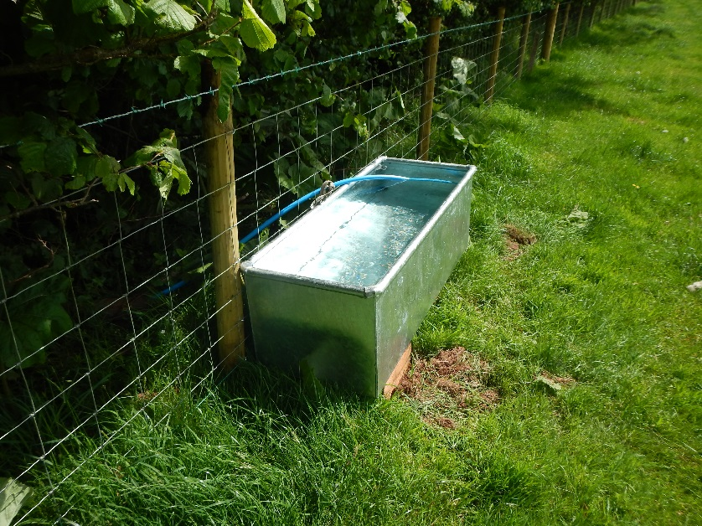
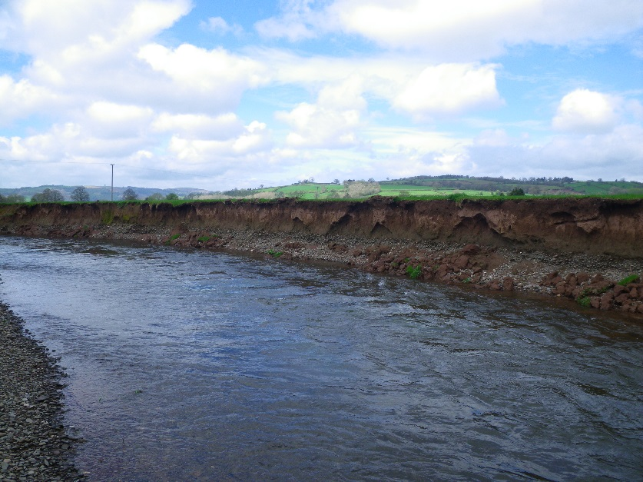
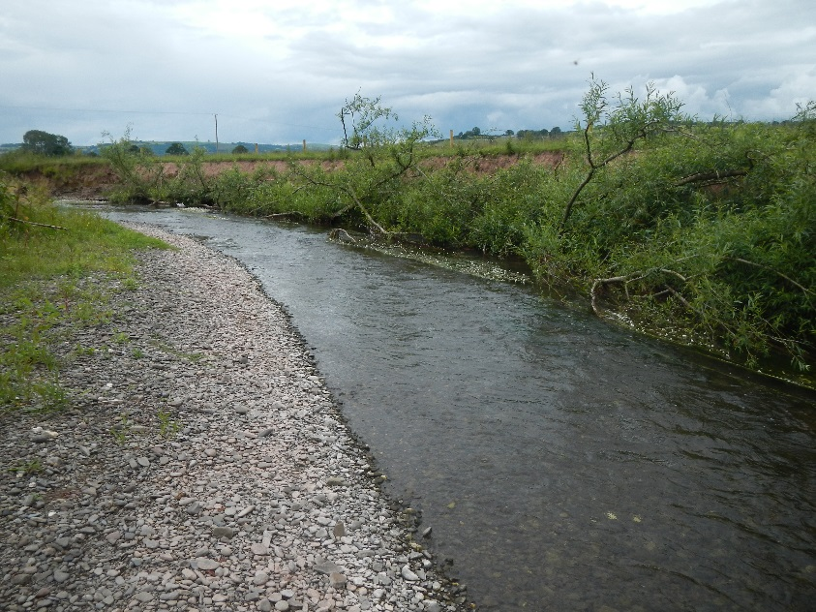
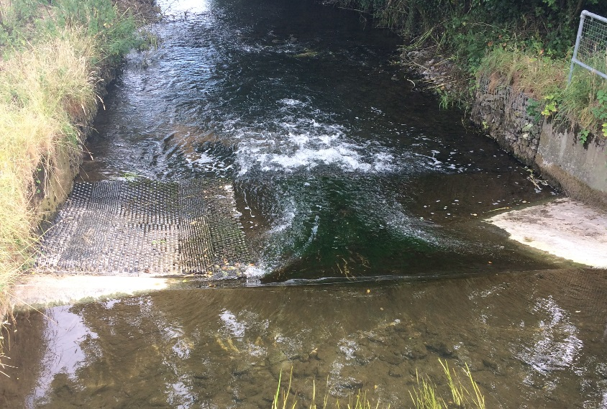
What can be done
Stock fencing
Alternative water
Bankside revetment
Improve access

Slide 9
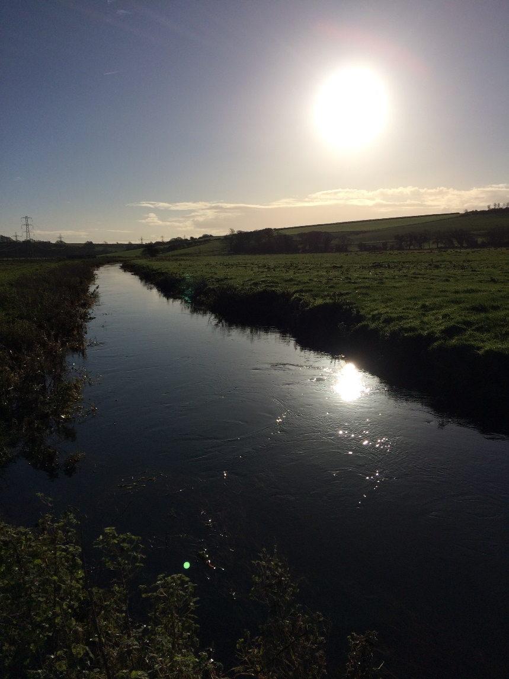
Thanks for listening!
Any Questions?

