Slide 1
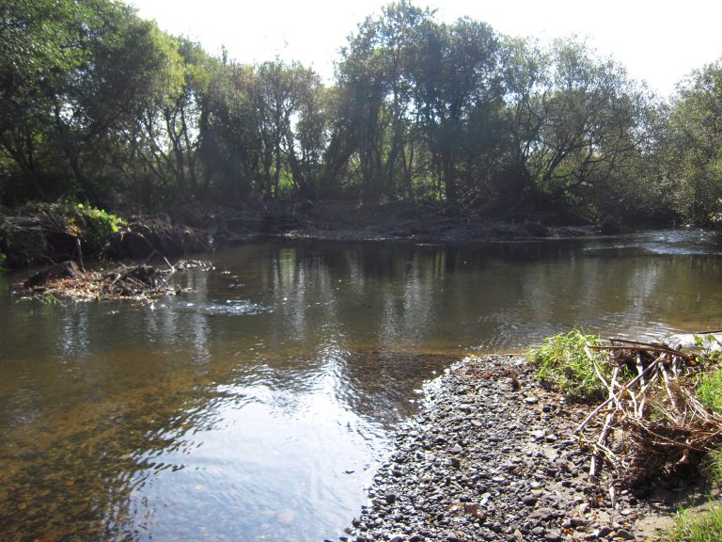
South East Wales River Trust: Your River A report on the survey & results
Jo McGreal & Gwenno Edwards
The Co-production Network for Wales
@copronetwales #coproduction

Slide 2
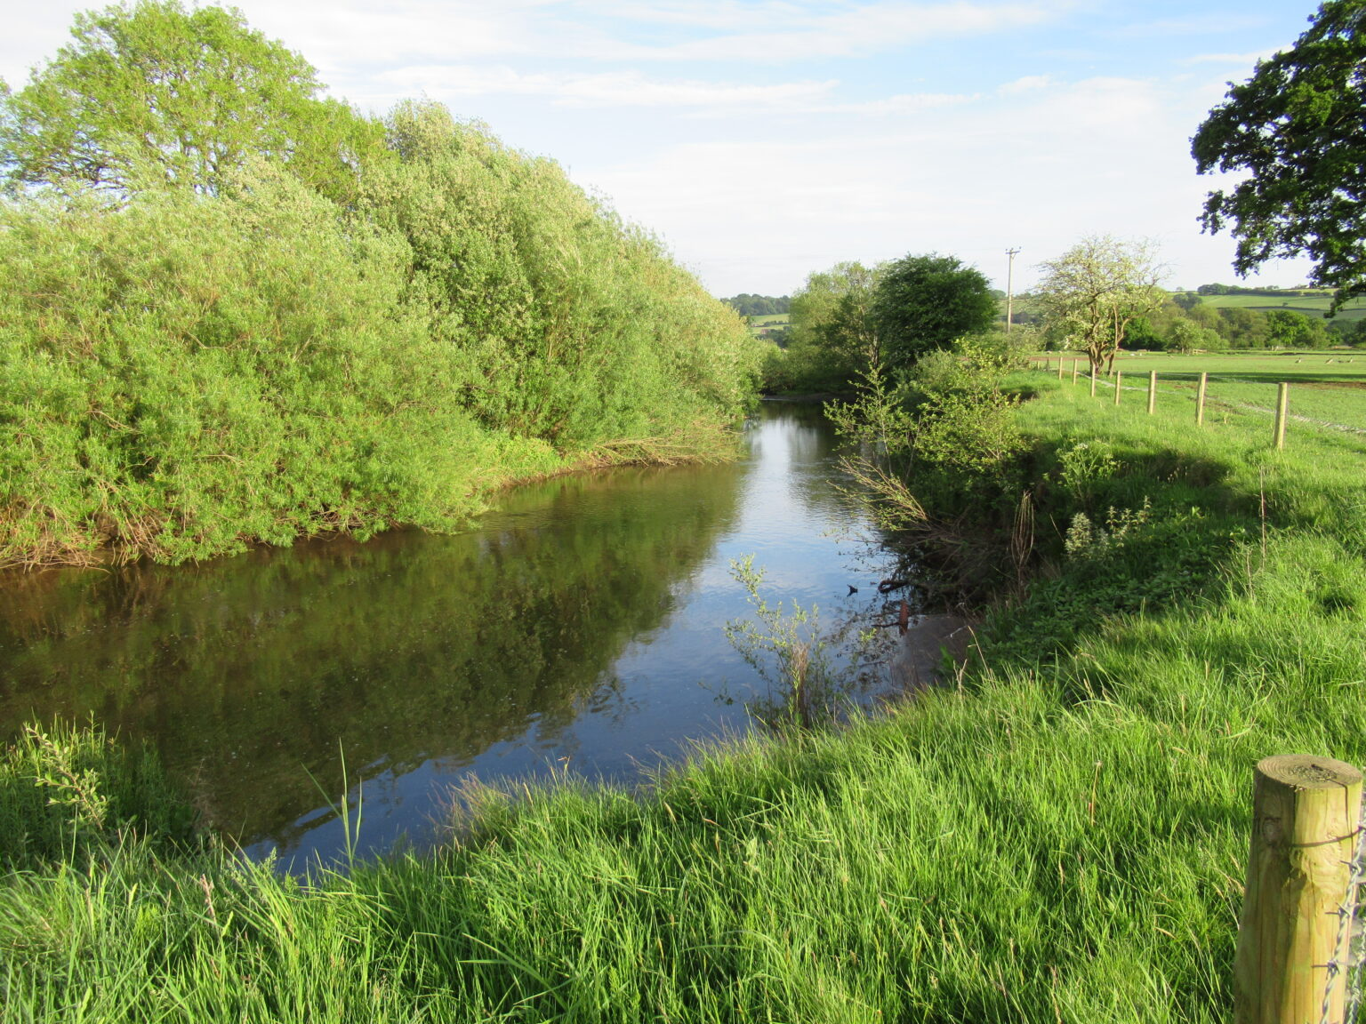
South East Wales River Trust: Your River: Summary
SEWRT has been successful in receiving a National Lottery Heritage Fund grant to conserve the stretch of the river Ely between St Fagans and Miskin.
A survey exploring connection to the river, perception of river quality and interest in engaging with the work of SEWRT received 39 responses:
The majority of respondents use the river to access nature and walking. Health and wellbeing were also recognised benefits
54% believe their river to be unhealthy
Pollution and Sewage are perceived to be the main reason
56% are interested in the work of SEWRT
Response indicates there is an interest in engaging with activities which also support the river and the environment.

Slide 3
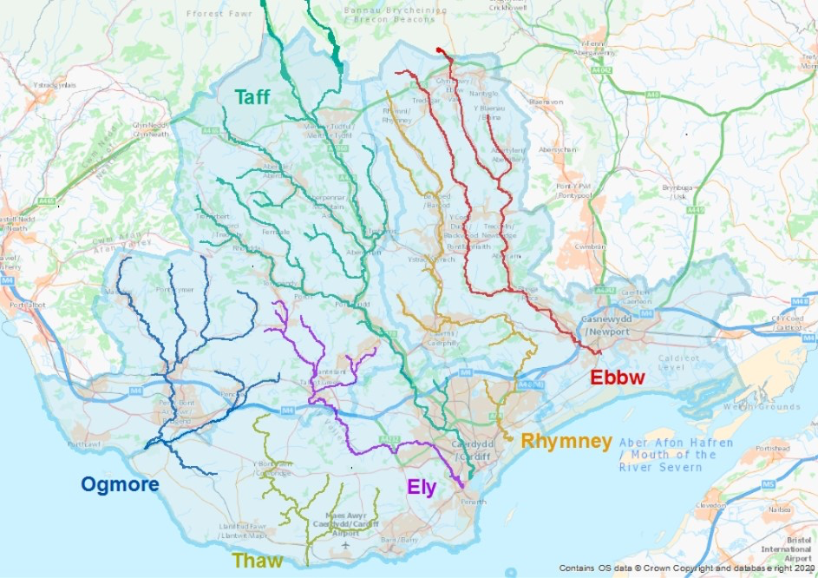
Context for the work
The South East Wales River Trust (SEWRT) is a small local charity working to protect and improve the rivers across the former South East Wales industrial valleys. The organisation works with volunteers and alongside communities and nature organisations to improve the health of the local waterways. This in turn brings benefits to both people and nature alike.
SEWRT has been successful in receiving a National Lottery Heritage Fund grant to conserve the stretch of the river Ely between St Fagans and Miskin. This area is a Site of Special Scientific Interest (SSSI) and is recognised as 'the best station in Wales for Aconitum anglicum (Monkshood)'.
The site also provides a vital corridor for other protected species including the European otter, the water vole, the river lamprey, sea lamprey and Atlantic salmon. The resilience of both the site and the species are under threat from issues such as overgrazing, loss of tree-cover and shading and the impacts of invasive species.
Map showing the area of SEWRT’s work across the South East of Wales

Slide 4
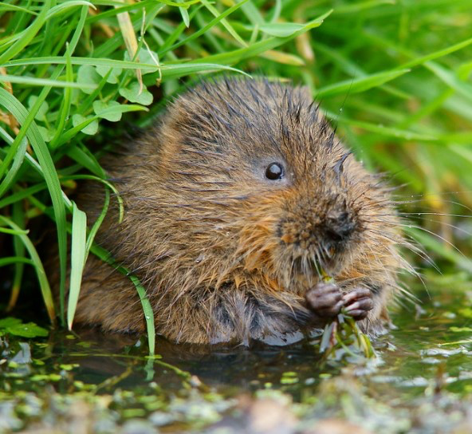
Engaging with the community
SEWRT are working to restore and enhance the Ely Valley thereby improving the longer term outcomes for both nature and people. Local communities are key to this; only by working together can the river be protected and the benefits for water quality, wildlife, the wider communities and future generations be realised. The purpose of this strand of work is threefold:
To gather insight on local use and perception of the rivers and the wildlife it supports;
To raise awareness of, and generate support for, the work of the SEWRT in protecting the Ely valley and;
To inform future work plan and engagement activities.
The Co-production Lab Wales were commissioned to support the development of this work by:
Facilitating an internal workshop with members of the SEWRT team to agree survey objectives, purpose and audience;
To work alongside the SEWRT team, to design a user friendly and accessible survey that meets the research objectives This survey is housed and owned by SEWRT.
To develop ideas for hosting interesting, inclusive and motivating events to support the research objectives.

Slide 5
Workshop results

Slide 6
Feedback from the internal workshop
The workshop was attended by 6 member of the SEWRT team. The purpose was to develop understanding of the benefits of working with people and and communities and, to agree the objectives of the survey.
The workshop demonstrated that while there is a strong appetite for working closely with communities and a recognition of the benefits this way of working can deliver for the organisation and for the river, the benefits for the people and communities involved were harder to capture. This emphasised the need for the survey and other engagement activities to development that understanding.
Organisational benefits:
Identification of stakeholders and how to reach those outside of the organisational comfort zone
Enhance the reputation of SEWRT among peer organisations
Building the team
Support for projects and environmental work
Improve internal knowledge of sites
Assist future fundraising
Better understanding of potential partners and the communities which neighbour the river.
River & environmental benefits:
Local communities reengaged with the river and wildlife leading to better stewardship of the river/ local environment
Awareness of human impact
Support for habitat improvement activities
Valuing of river leading to better care.
Community benefits:
Improved connections and opportunities to share information
Increased awareness of the river and it’s value
Understanding of water quality and impact of actions and behaviour.

Slide 7
Feedback from the internal workshop
Hopefully it will get us working more closely together as a team like fellow rivers trusts.
Educate the local communities on how to improve river and environmental quality.
Increase landowners and local communities sense of care for the river.
People within the communities are aware of what a good quality and bad quality river looks like and how this can be changed.

Slide 8
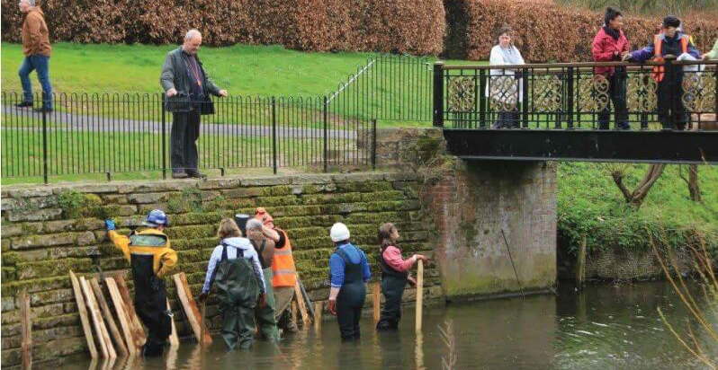
Aspirations and expectations
The following aspirations were identified during the workshop;
Short term (survey)
Understand local perception and use of river
Improve awareness and understanding of targeted communities local to the river regarding:
The value and importance of river & attributes
The work of SEWRT
Enhance the reputation of SEWRT locally, with funders and other organisations
Build network and relationships (both new and existing)
Gather insights to inform future activities
Meet funding aims
Longer term
Generate local ownership and care of river
Support the work of the team
Develop research methods and inform future work
Inspire people to keep working and value the river
Ongoing evidence capture to support future work and funding bids
Comprehensive directory of who links to river - eg.landowners, especially difficult in urban areas
Increased level of awareness and understanding of local communities towards river attributes

Slide 9
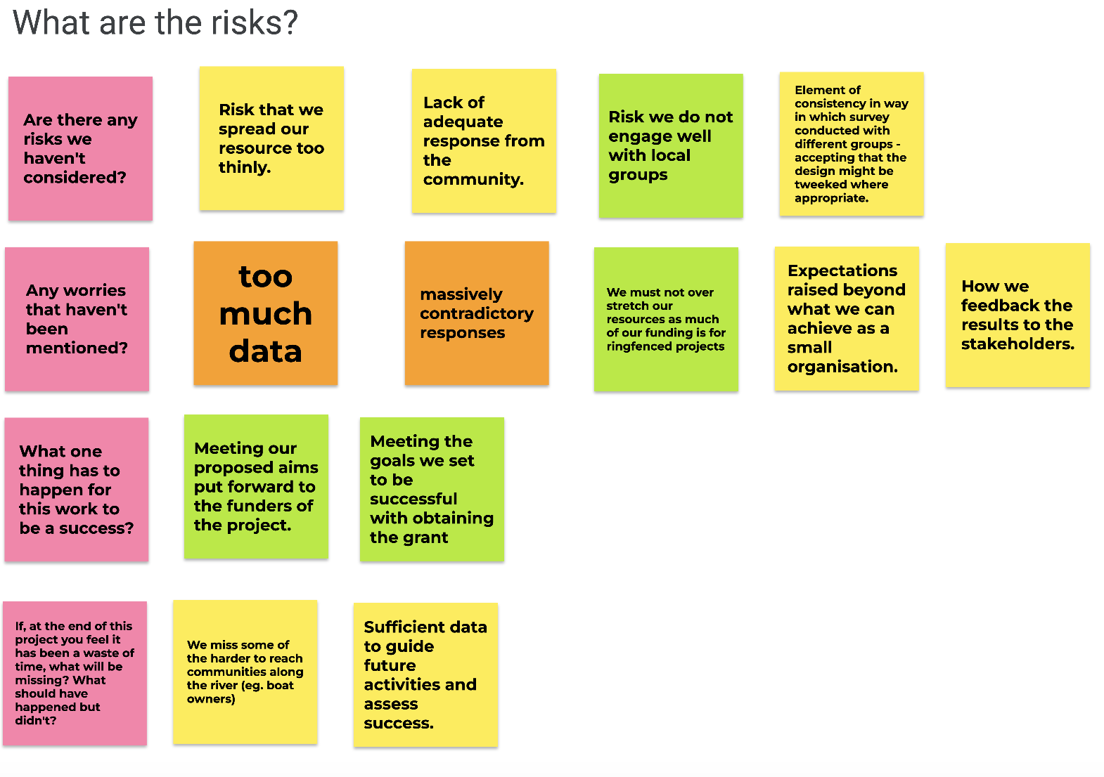
Risks and concerns
The team acknowledged that they were a small organisation and team. While they are ambitious in their outlook the work needs to be managed to meet with capacity and to mitigate risk of over extending and over promising.
While working cooperatively with local communities will bring many benefits, the team are realistic about the need to manage internal and external expectations while still working towards their goals.
Discussion of risk during the workshop

Slide 10
Stakeholder mapping
The team began the process of stakeholder mapping with a particular focus on the survey.
As the expectation is for the survey to run over a longer period of time the organisation will stagger how it approaches each audience strand.
It was agreed to use social media as the initial approach to sharing the survey.

Slide 11
Survey results

Slide 12
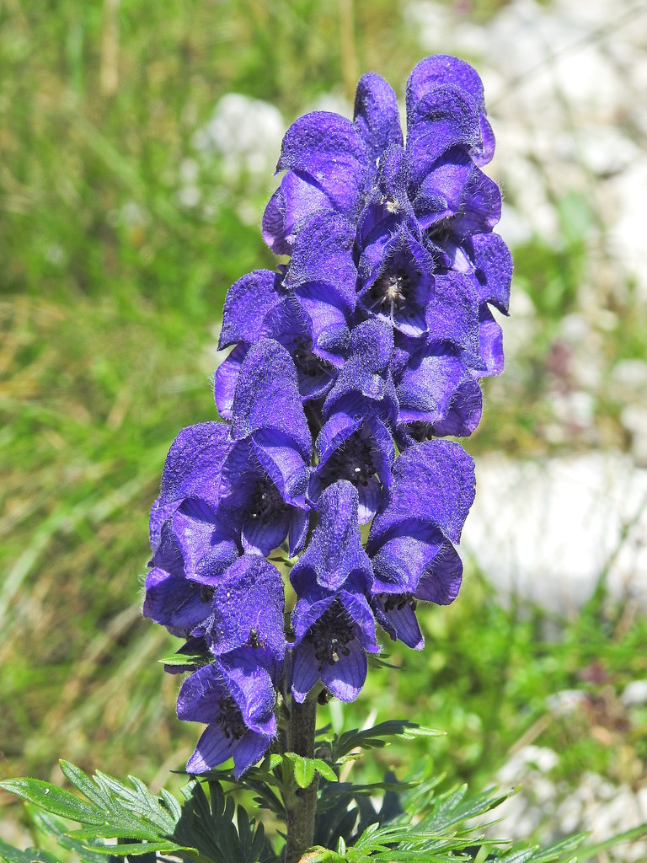
Survey
The bilingual survey was distributed via social media and SEWRT organisational contacts. The responses were collected between 17th Nov - 8th February 2024.
While the expectation was that response times would cluster around distribution and reminder dates, there was no discernible pattern to when people completed the survey.
39 responses were received, 38 in English and 1 in Welsh.
It is worth considering if the small number of Welsh responses links to the distribution method and social media targeted. Cross referencing the distribution list with a stakeholder map focusing on Welsh speaking communities and related social media links would support this.
It is worth noting that SEWRT is a small organisation and the survey is targeting a specific geographical area. The Rivers Trust ran The Big River Watch survey during the weekend of 22 -24 September 2024 and received 3,600 survey returns. They are a large UK organisation with access to UK media and a range of other channels. While it is not directly comparable, SEWRT did well to get the results they did. It is also the start of their process.

Slide 13
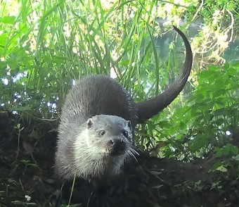
The survey focused on the following themes:
Connection to the river: location, time spent, use of the river;
Perception of river quality: health of the river, wildlife and nature observed;
Connection to people and communities: awareness of SEWRT and their work: ways to engage, topics and activities of interest and support for the work.
How did people hear about the survey? 29% received the survey through a local nature of community group
32% received the survey directly through social media
39% indicated ‘other’. For future surveys, it would be helpful to review these response and provide more specific options to reduce this number
22 people positively indicated they want to stay in touch and support the work

Slide 14
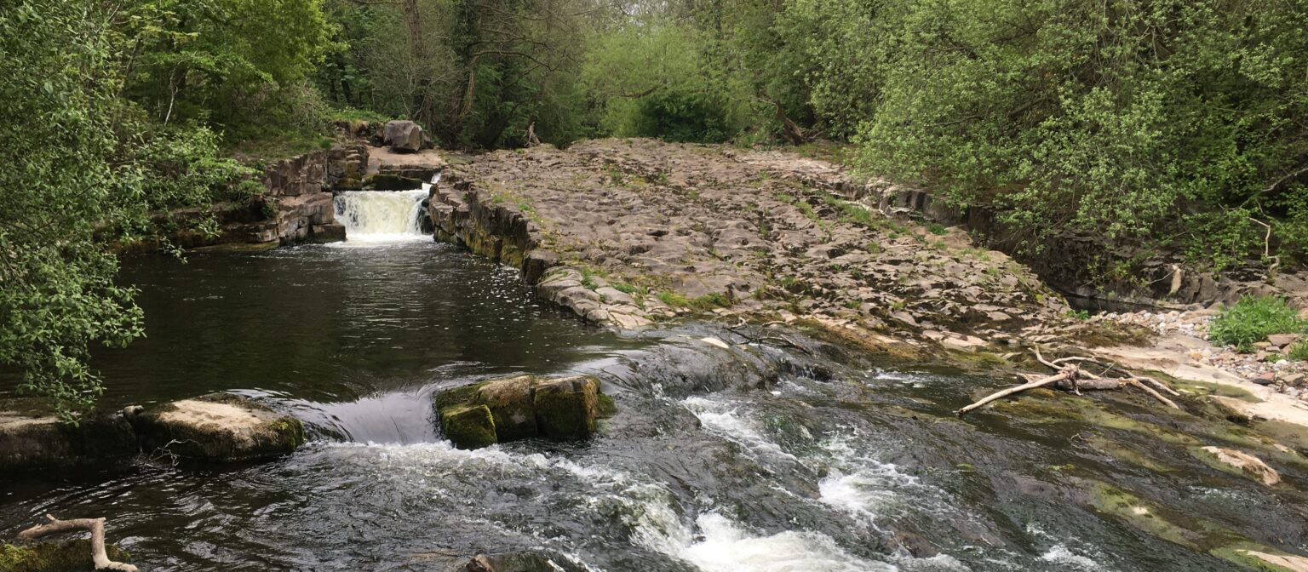
Connection the River
38 respondents identified their local river:
38% indicated the river Ely
25% indicated the river Taf/Taff
Other rivers included the Ogmore, Clun, Llwyd, Ewenni Fach, Rhondda & Usk
26 people also spent time by other rivers:
the Ely was the second river for 5 respondents
4 people only accessed 1 river
The list of other rivers was quite broad and included the Usk, Wye & Rhymney

Slide 15
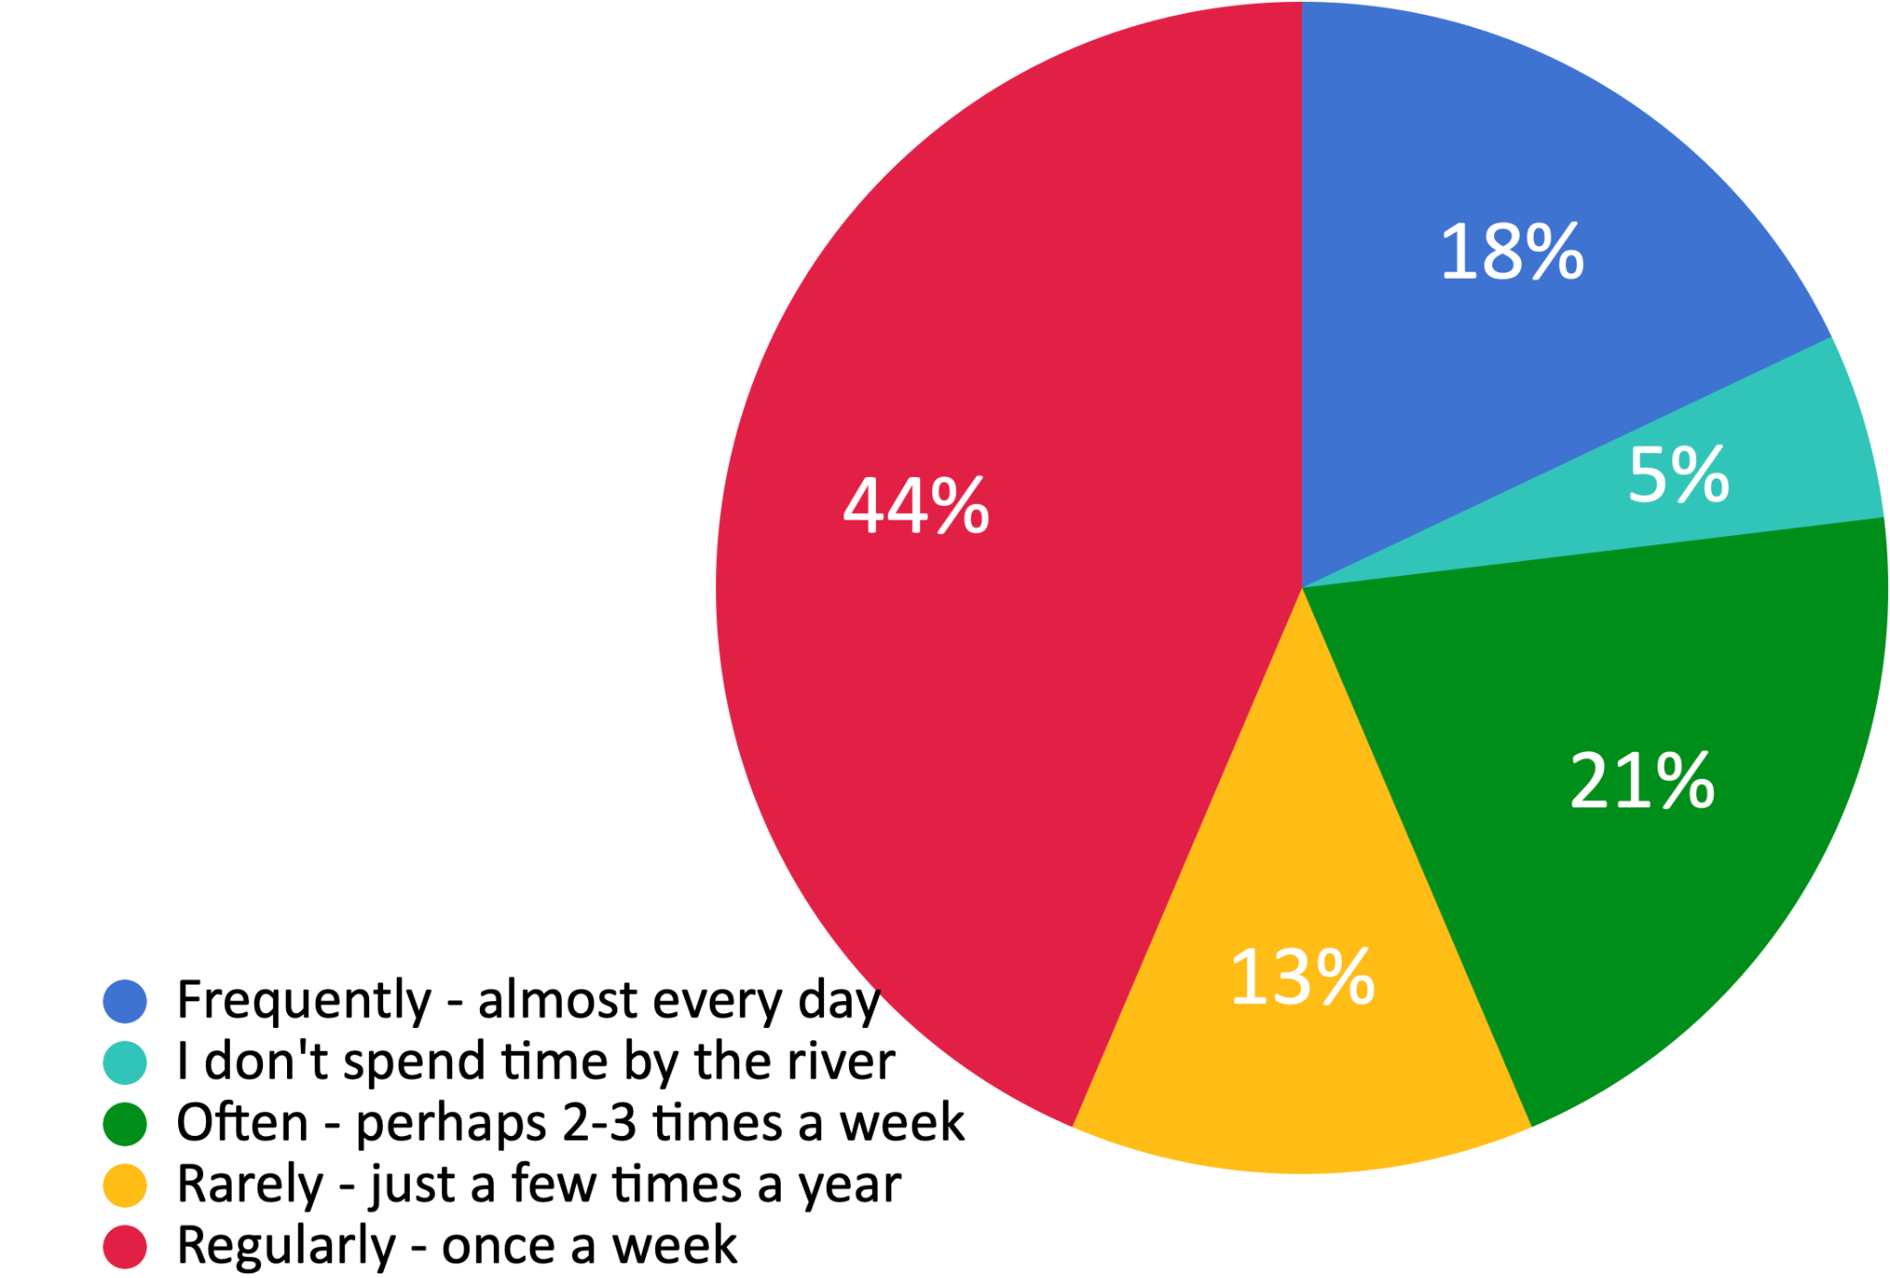
Connection the River
The majority of people spend a significant amount of time by their river with only 5% of respondents indicating they don’t spend any time at all.
Arguably the people who completed this survey are likely to be those who have an interest. It would be helpful to promote the survey in a variety of settings and through the other stakeholder mapping strands in order to build a more complete picture.

Slide 16
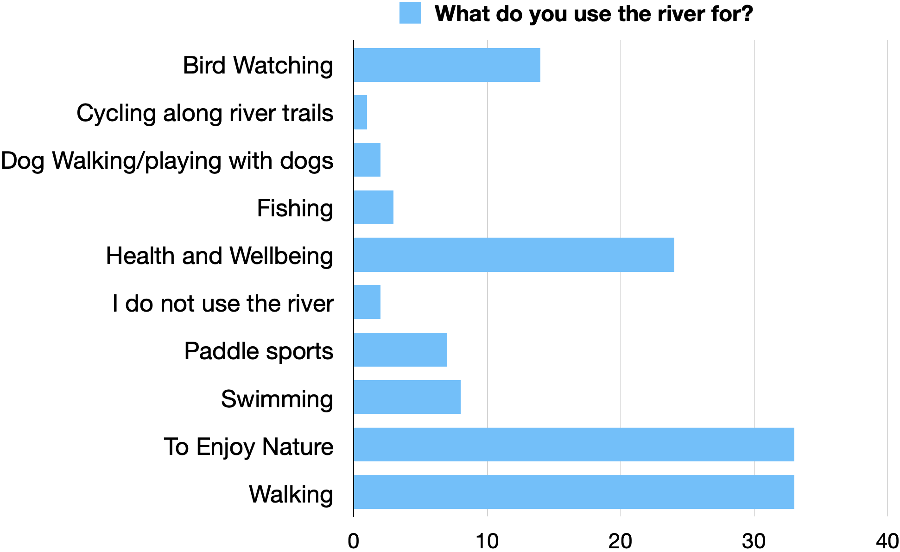
Connection the River
Access to nature including bird watching, appears to be the main motivation for using the river. This is followed by the opportunities offered by the river for health and wellbeing and walking.
It is interesting that water based activities do not score highly. There are a number of comments throughout the survey about limited access to rivers in South Wales and this maybe a factor which impacts river use. However pollution appeared to be the biggest barrier.
It flows through my garden and I walk up it every day.
There is very poor access to most local rivers in the Rhondda. So on days out to random locations and waterways.

Slide 17
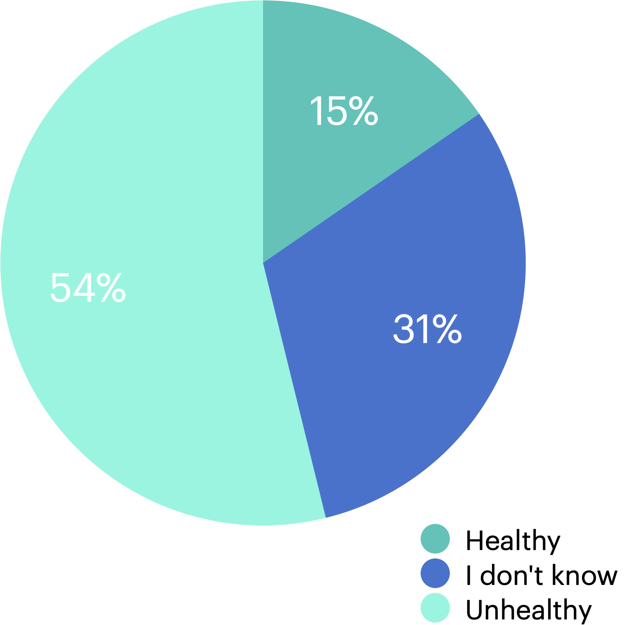
Perception of river quality
Only 15% of survey respondents believe their river to be healthy. In comparison, 73% of the Big River Watch respondents indicated their river was healthy.
Perception can be misleading and it would be interesting to understand the difference media reporting makes to this figure.
However, the majority of SEWRT respondents were able to evidence their response as indicated by the quotes on the following page. While a small number identified reports e.g. media reports regarding sewage, NRW pollution reports, the majority of provided examples from their own experience.

Slide 18
Perception of river quality
“Dirty water that I often don’t want to go into, can barely see the bottom. Litter everywhere.”
“Everything it touches dies. It was once full of reeds and plants, but now the river itself and the banks either side are dead. Although we frequently see king fishers, otters and other wildlife, the amount of fish is tiny. The water is grey and smells unclean compared to other rivers. It's widely regarded that this is due to the pollution from the water released by WW/DC and the 'cake' fertiliser supplier by the water companies that is spread on neighbouring farmland and washes into the river. Recently farmers have left silage bales along the river banks and they have been washed down stream, leaving huge amounts of plastic waste throughout the village of Peterston-super-Ely.”
“There appears to be little biodiversity and multiple sewage treatment plants feed into it, flushing inadequately treated sewage into the river.”
“Agricultural runoff, over management of riverbank, biodiversity loss.”
“There is always a lot of rubbish in the river, when kayaking down there are car tyres and lots of other rubbish stuck on branches and in the water”
“There seem to have been more reports of sewage getting into the rivers in and around Cardiff in 2023 than previous years. Pretty grim stuff, especially as we and many others swim in the river in the summer months, and it's used by many people for things like kayaking and paddleboarding. We avoid it after rainfall, but not sure that's enough.”
“Sewage spillages are particularly bad, lots of litter and debris in the river.”
“Recent press regarding Dŵr Cymru's pollution of many rivers in Wales”

Slide 19
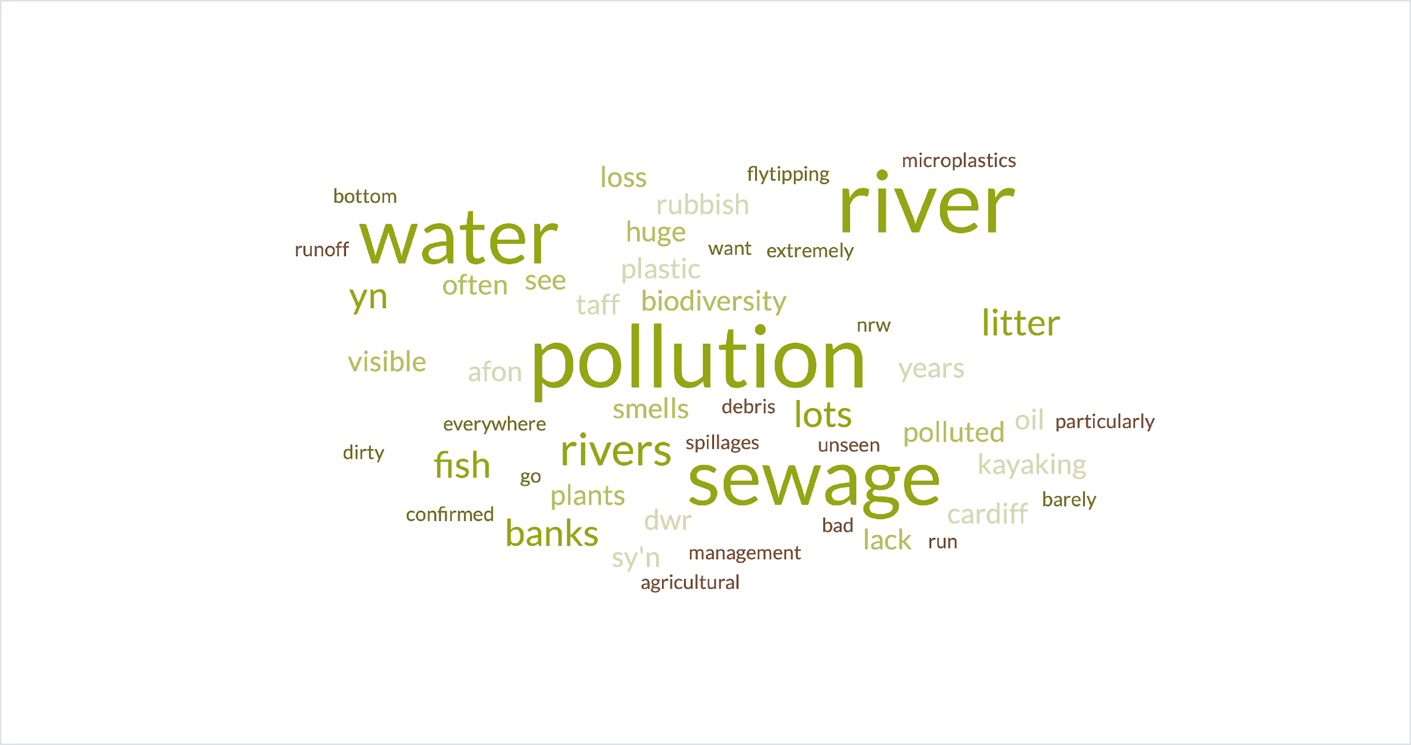
A word cloud from responses indicates that respondents see pollution and sewage in their river

Slide 20
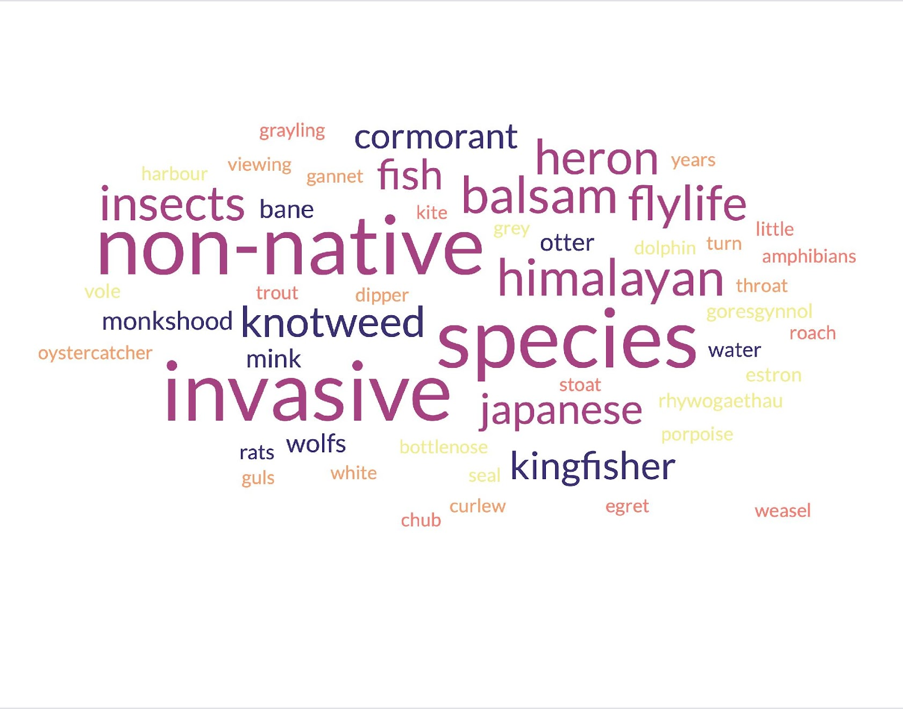
Perception of river quality: nature
The majority of respondents indicated they were aware of, and had seen, at least 1 non-native species near their river. However, there was a good range of other species observed with everyone reporting seeing at least one native species.
8 respondents identified having seen Monkshood (Wolf’s Bane)
Other examples include perch, kites, rats and whitethroat.
One person indicated they had been observing their river for over 50 years.
Another identified a reduction in water voles caused by mink.
A word cloud indicating the range of nature and wildlife seen by the respondents.

Slide 21
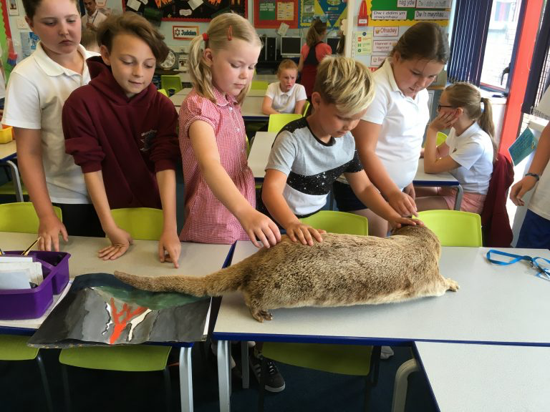
Connection to people and communities
One purpose of the survey was to support SEWRT to build relationships and plan activities. 56% of the people who responded indicated they would like to stay in touch and hear more about the work of SEWRT. 14 of these indicated they would like to actively be involved either through events or in the work of SEWRT.
Would you like us to stay in touch with you?
Yes - I only want to know more about the RePrEEV project and how you use this data | 8
Yes - I would just like to know about the different events and activities you run | 5
Yes - Please keep me up to date on all aspects of your work and the different ways I can be involved | 9

Slide 22
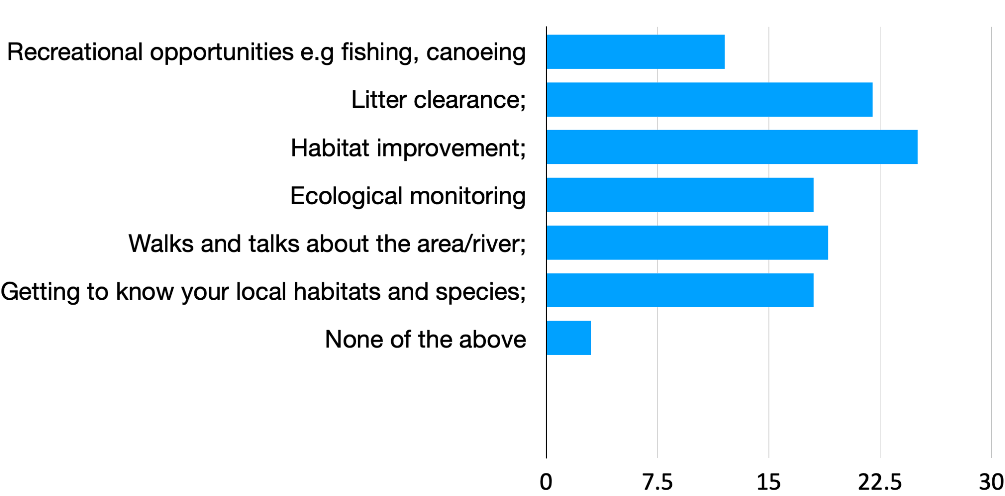
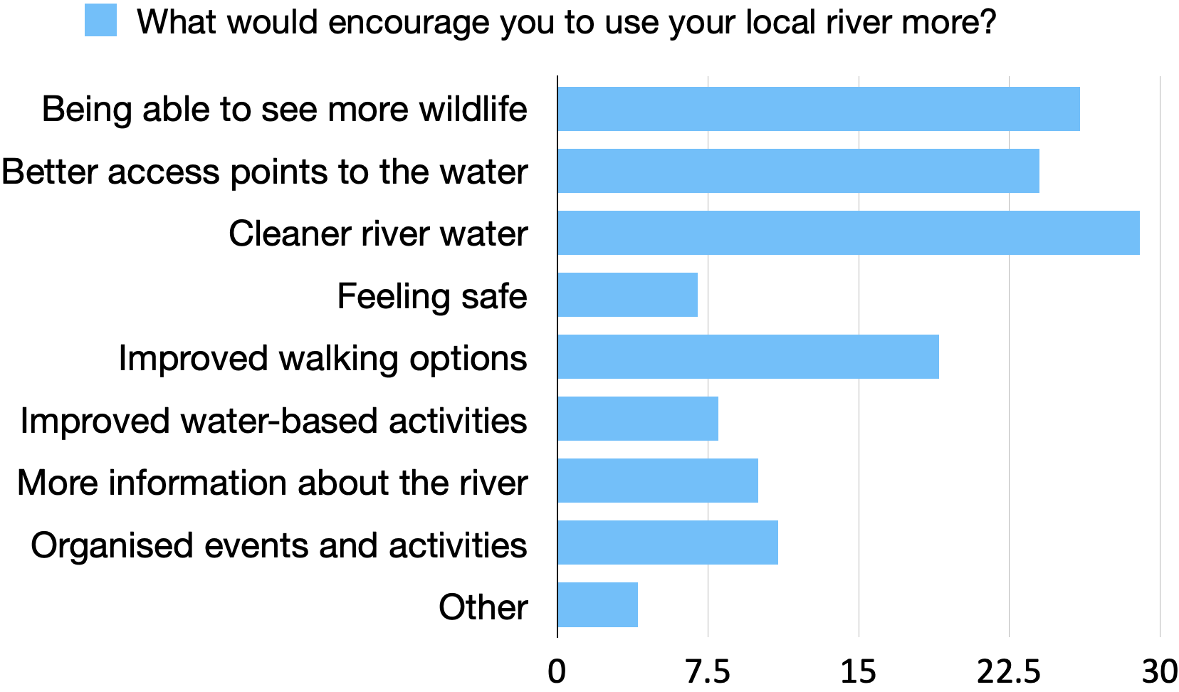
Connection to people and
communities
There is a link between the activities SEWRT can provide and the ways in which SEWRT can support people to use the river.
Activities people would like
Activities which provide information about local habitats and species will also encourage people to access the river. Litter clearance and habitat improvement will engage people and benefit the river.

Slide 23
Connection to people and communities
While pollution and water quality factor highly the issue of access was also raised throughout the survey.
This includes physical access to the river as well as accessible activities for people to join.
Benches, picnic benches, places to stop and relax
Access via public transport e.g. buses across Cardiff instead of directly to the City Center then back out again
A statutory right to access the riverside through access reform legislation as they enjoy in Scotland and other reasonable countries.
My kids would love to be involved in a project
Problems solved, help from other people like yourself, contact from you about issues
Removal of unnecessary restrictions and impediments to public access to and along the water.

Slide 24
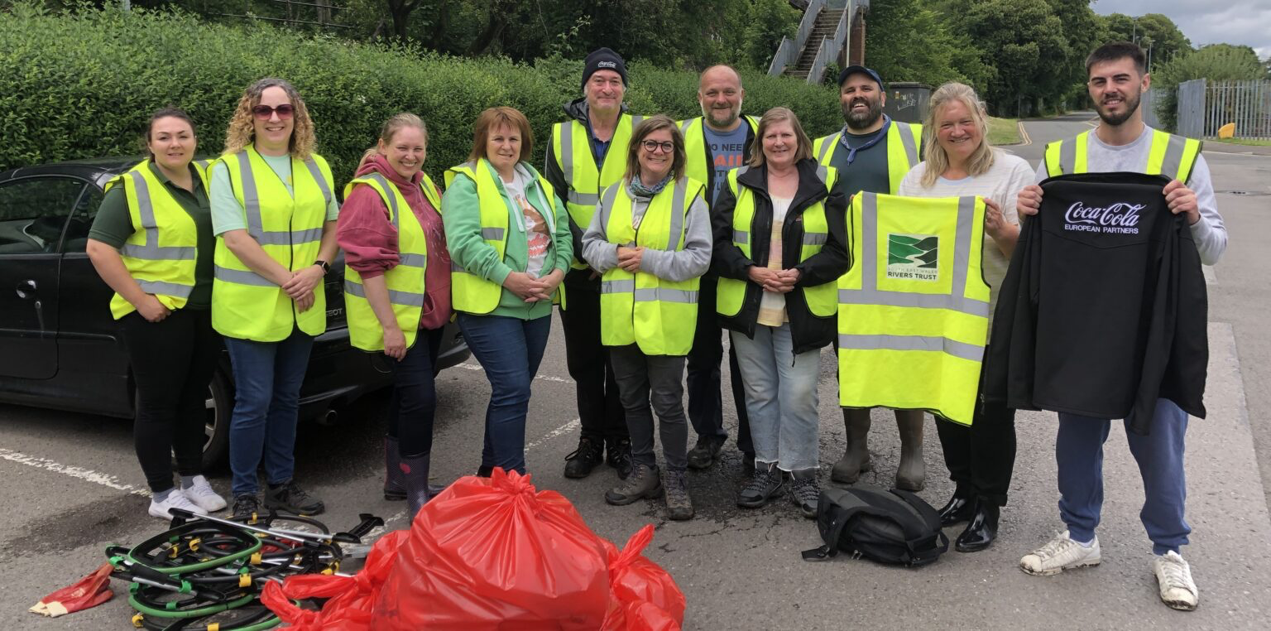
The survey has started to deliver on the shorter term aims agreed for this work:
Results indicate that pollution and access are concerns for local people and communities;
It has identified some of the barriers to people accessing their river
It has indicated the types of activities and ways of engaging with people
It has generated support for the work of SEWRT with people requesting to stay involved and for opportunities to care for their river.
As a tool, it can be developed and, if continued to be used, it will provide the scaffolding around work plans, be a tool to promote the work of SEWRT and a means to start local conversations.
Conclusions and recommendations

Slide 25
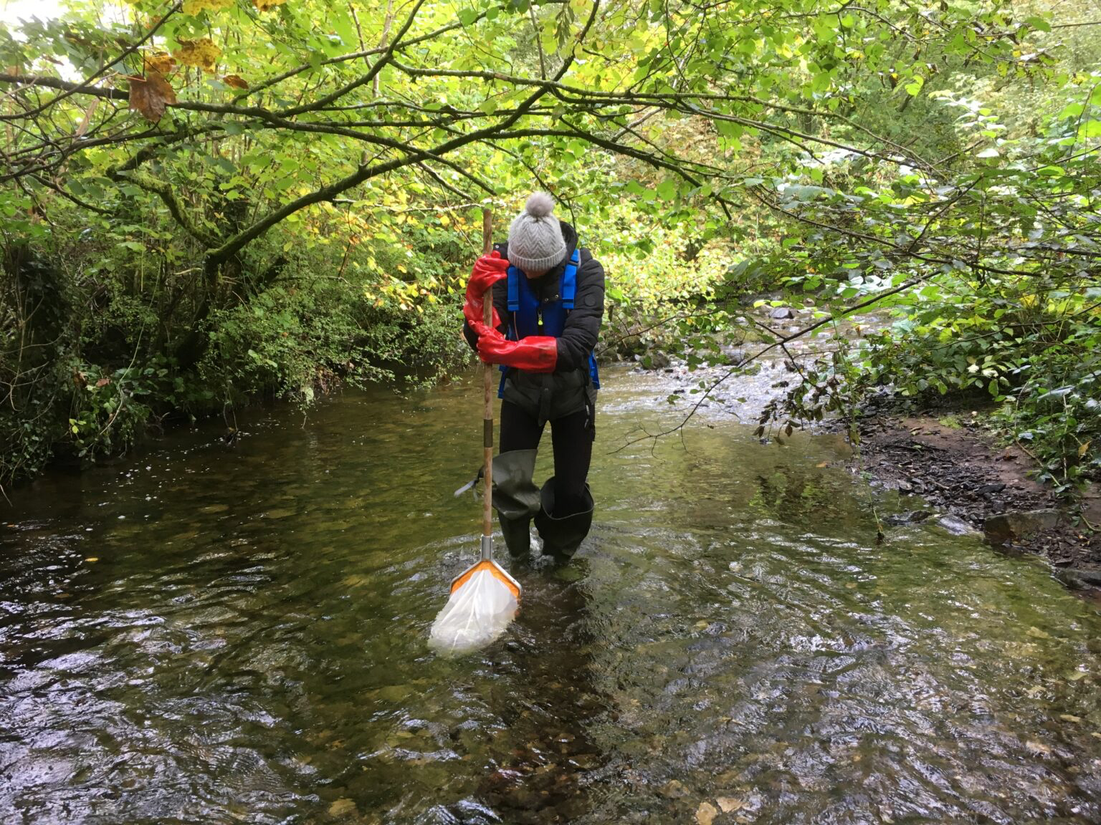
Conclusions and recommendations
The survey provides a good basis for the longer term aims and the insight it gathers will inform the organisation. However the long term goals of generating local ownership and care of river and, inspiring people to value the river, would benefit from a co-productive approach.
While generating connections to the river and connections to SEWRT are intertwined as objectives, they are not interdependent. SEWRT can act a bridge between people and their river by enabling access and providing opportunities for them to care for their rivers. Doing so will help establish and consolidate relationships. However, to generate local ownership requires a deeper understanding what is important to communities. This is difficult to capture in survey form.
The need to balance outcomes for people and outcomes for nature warrants shared knowledge, information and conversations between conservationist and communities. Some suggestions for activities are on the next page.

Slide 26
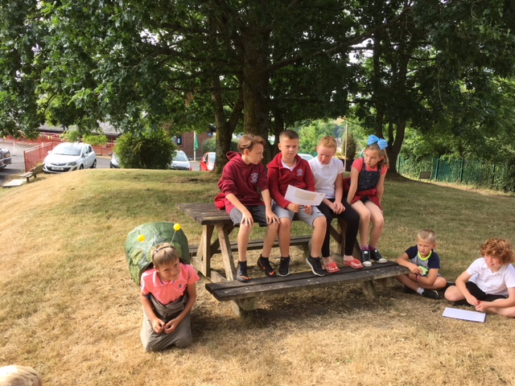
Seed Ideas for engagement
Connect with the people who have indicated an interest; invite them to an event or activity and use part of the time to host a conversation about how to work together
Develop a citizen led approach to tackling pollution
Work with schools and youth groups to adopt a section of the river
Attend summer fairs and ask people what they want to know and do
Run a Fun Palace connected to the river so people can share their skills and knowledge
Hold a Community of Enquiry to find out more about what the river means to people
Hold an online photo exhibition so people can submit photos of wildlife or examples of places by the river which are important to them
Provide opportunities for people to volunteer and share their knowledge of the river

